Slide 2
A Loving People
A Righteous People
A Unified People
An Obedient People

Slide 3
A Obedient People
Philippians 2:12-13
So then, my beloved, just as you have always obeyed, not as in my presence only, but now much more in my absence, work out your salvation with fear and trembling; 13 for it is God who is at work in you, both to will and to work for His good pleasure.

Slide 4


Slide 5
A Obedient People
John 3:36
He who believes in the Son has eternal life; but he who does not obey the Son will not see life, but the wrath of God abides on him.

Slide 6
A Obedient People
Romans 6:16
Do you not know that when you present yourselves to someone as slaves for obedience, you are slaves of the one whom you obey, either of sin resulting in death, or of obedience resulting in righteousness?

Slide 7
A Obedient People
2 Thessalonians 1:8
dealing out retribution to those who do not know God and to those who do not obey the gospel of our Lord Jesus.

Slide 8
A Obedient People
2 Thessalonians 3:14
If anyone does not obey our instruction in this letter, take special note of that person and do not associate with him, so that he will be put to shame.

Slide 9
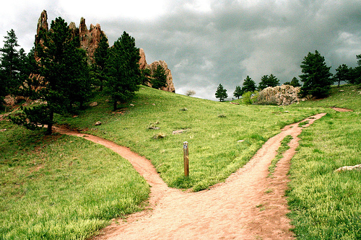
A Obedient People

Slide 10

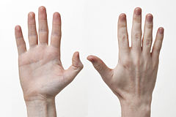
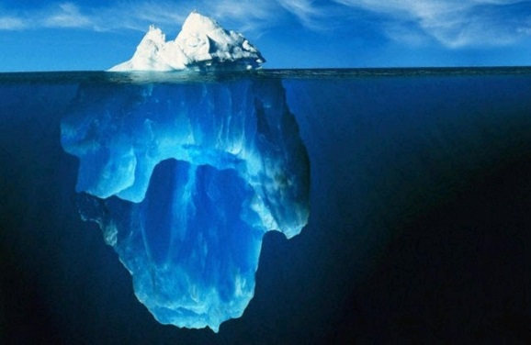
Attention
Action
Attitude

Slide 11
Attention
A Obedient People
Ephesians 6:4
Fathers, do not provoke your children to anger, but bring them up in the discipline and instruction of the Lord.

Slide 12
Attention
A Obedient People
Acts 5:29
But Peter and the apostles answered, We must obey God rather than men.

Slide 13
Attention
A Obedient People
Hebrews 11:8
By faith Abraham, when he was called, obeyed by going out to a place which he was to receive for an inheritance; and he went out, not knowing where he was going

Slide 14
Attention
A Obedient People
Hebrews 13:17
Obey your leaders and submit to them, for they keep watch over your souls as those who will give an account. Let them do this with joy and not with grief, for this would be unprofitable for you.

Slide 15
Action
A Obedient People
John 14:15
If you love Me, you will keep My commandments.

Slide 16
Action
A Obedient People
Romans 2:8
but to those who are selfishly ambitious and do not obey the truth, but obey unrighteousness, wrath and indignation.

Slide 17
Action
A Obedient People
Romans 6:12
Therefore do not let sin reign in your mortal body so that you obey its lusts.

Slide 18
Attitude
A Obedient People
Hebrews 5:9
And having been made perfect, He became to all those who obey Him the source of eternal salvation.

Slide 19
Attitude
A Obedient People
2 Corinthians 4:5
For we do not preach ourselves but Christ Jesus as Lord, and ourselves as your bond-servants for Jesus' sake.

